Slide 1

Connect2
A pandemic shouldn’t stop you from making friends!

Slide 2

What is Connect2?
Connect2 is a platform which gives students of any University a chance to socialize with their peers, based on their personality-type and the courses they have in common.
Paired with a questionnaire to predict the user’s personality type, Connect2 acts as the perfect avenue to start new friendships. (add stuff to notes)

Slide 3
Motivation
Due to the pandemic, our generation is missing out on socializing with their peers.
We wanted to see how different personalities work together, and upon further research we saw good results (make this better)

Slide 4
Tech Stack
scikit-learn library in Python for the Clustering Model
Google Cloud Platform (AI Platform) for hosting/deploying the model
Firebase and React.js for running the web-page.
Zoom Video Conferencing API
Big Five Personality Test Dataset

Slide 5
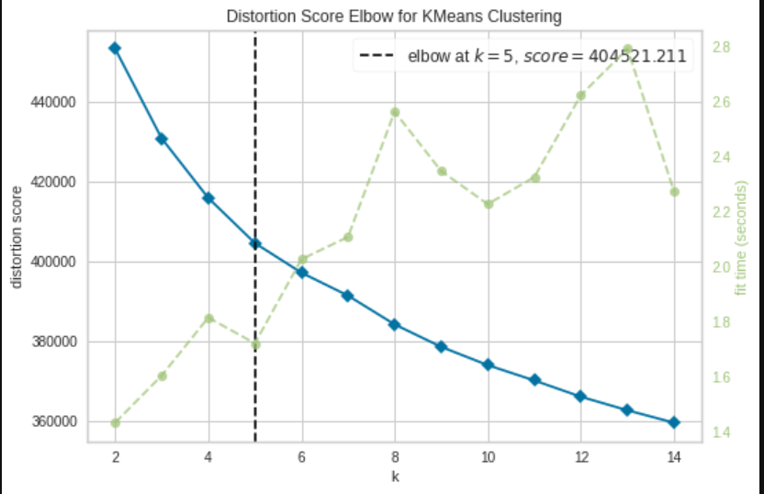
What data did we use?
Over 1M recorded answers, divided into 5 clusters using the Distortion Score Elbow with a sample size of 7000.

Slide 6
(demonstration, show the login page)

Slide 7
(filler)

Slide 8
Future scope
Let students combine their Google Calendars to sync with their course schedule and socializing time.
Built-in video calling, supported by services such as Vonage.
Do more research and customize web-app to use students’ interests on top of their personality types.

